Slide 1
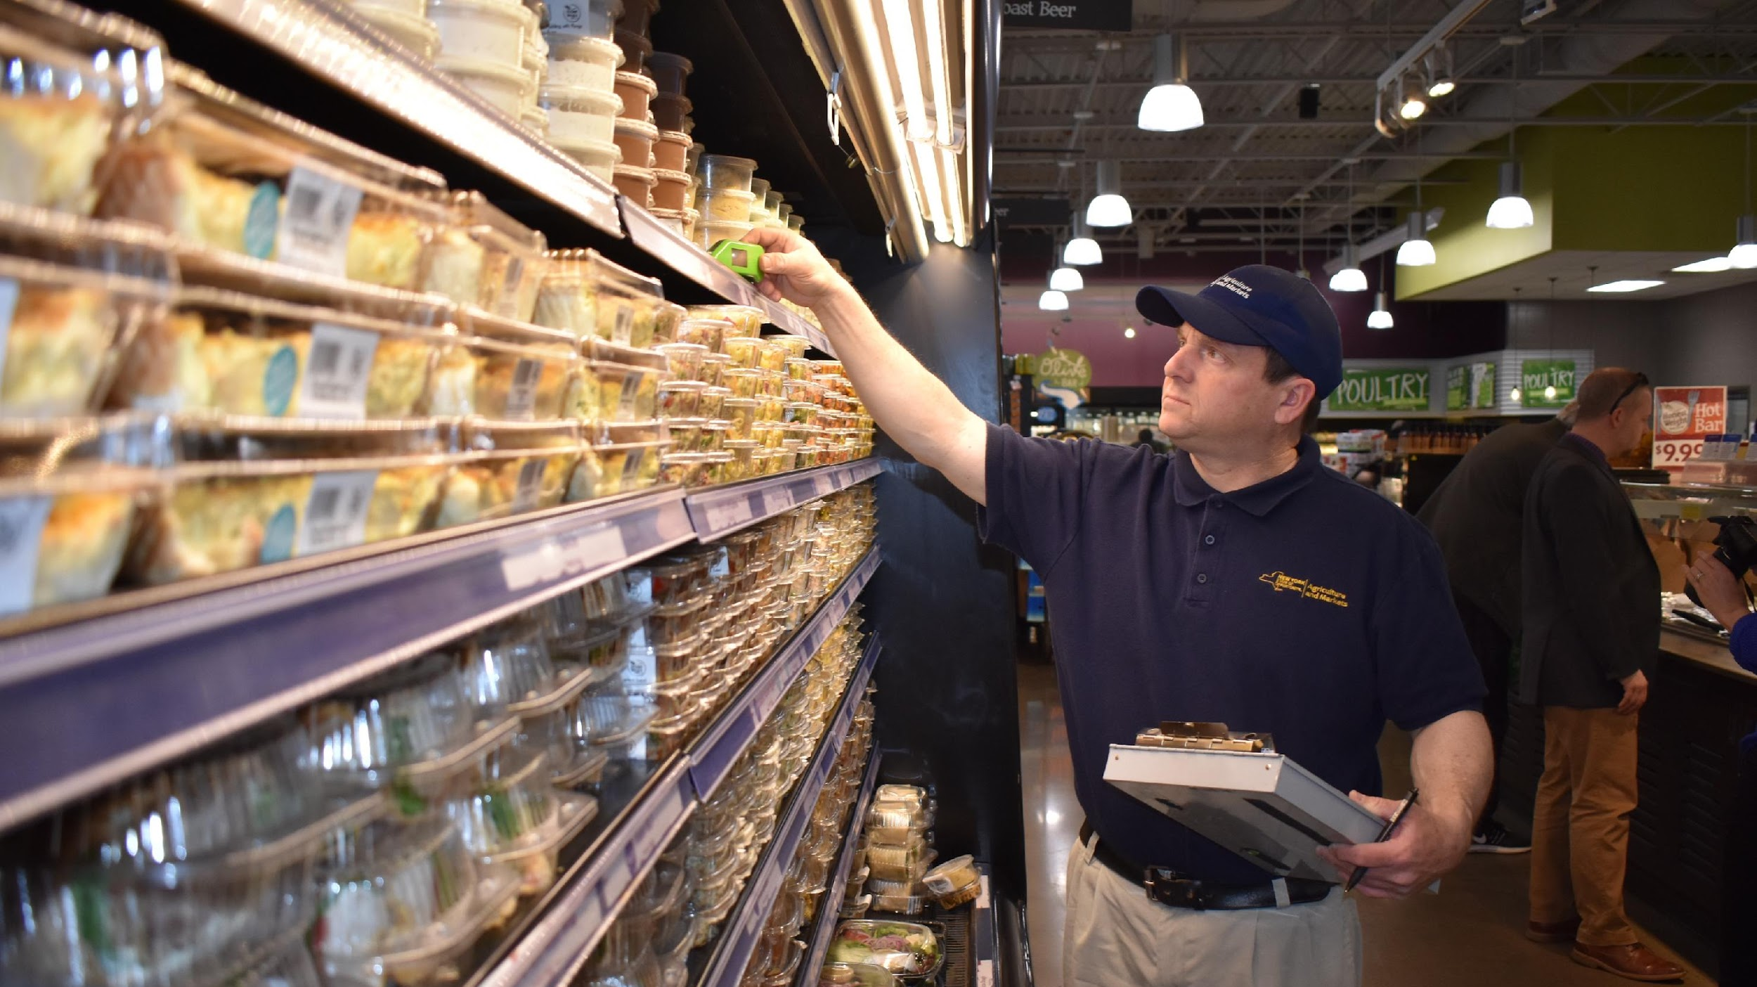
DATA602: PROJECT PRESENTATION TOPIC: ANALYZING AND FORECASTING FOOD SAFETY COMPLIANCE IN CHICAGO
BY:
SRUTHI PALADUGU (ID: FZ15577)

Slide 2







AGENDA
PROBLEM STATEMENT
DATA SOURCE
BUSINESS OBJECTIVES
PROJECT APPROACH
DATA PREPARATION & MODELLING APPROACH
CHALLENGES
CONCLUSION

Slide 3

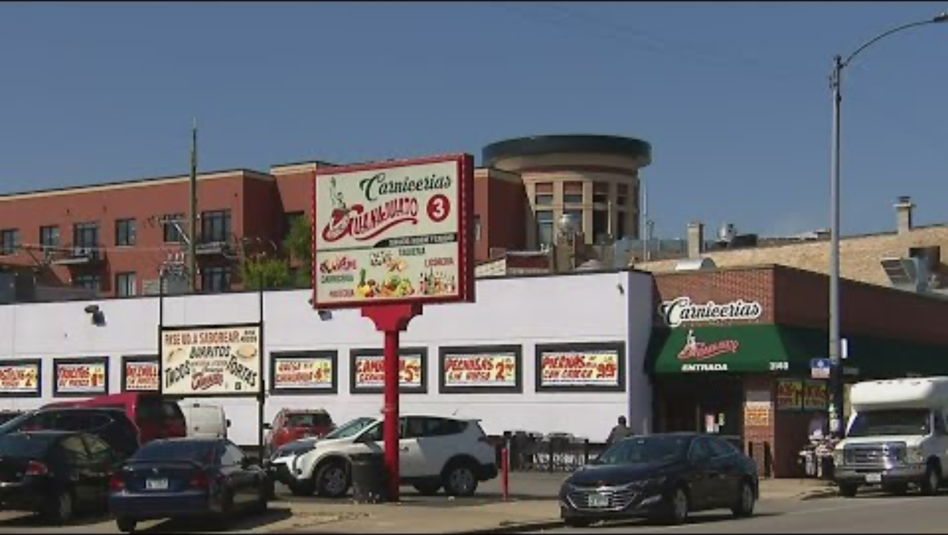
INTRODUCTION TO PROBLEM STATEMENT
Notes:
The recent Salmonella outbreak associated with a Chicago taqueria, affecting over 55 individuals, underscores a critical food safety challenge in the city. This incident highlights how important it is to have strict oversight and preventative measures in place to protect health of Chicago residents and safety when they eat out. Our project's objectives are to investigate the outbreak, pinpoint its origins, and evaluate any gaps in food safety procedures that might have contributed to the event.

Slide 4

DATA SOURCE
Now we analyzed data for the Food Protection Division of the Chicago Department of Public Health (CDPH) to conduct checks based on risk level and to forecast future outcomes.
Analysis points and predictions will be elaborated in the next slides in the form of business objectives.

Slide 5
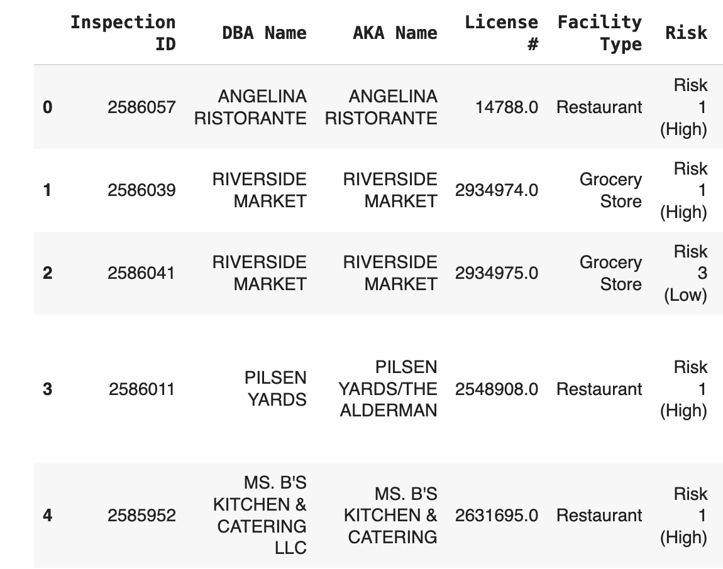
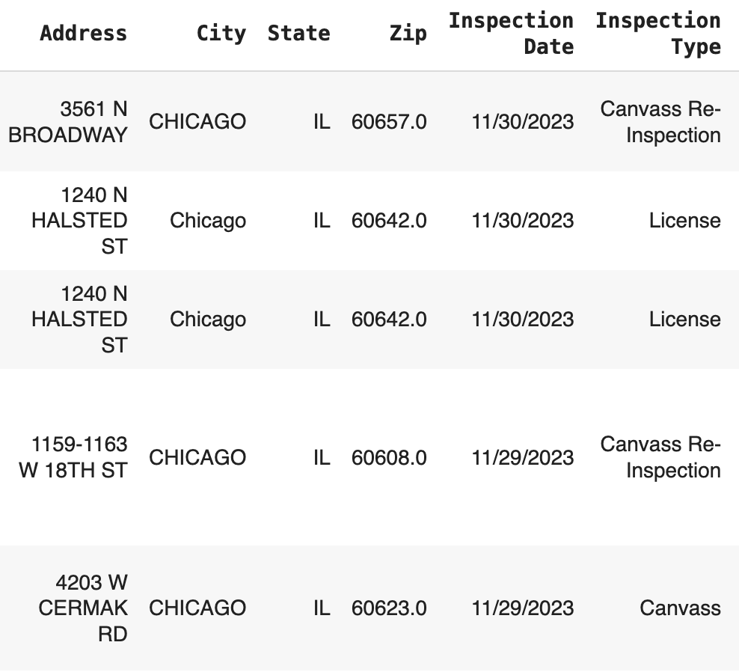
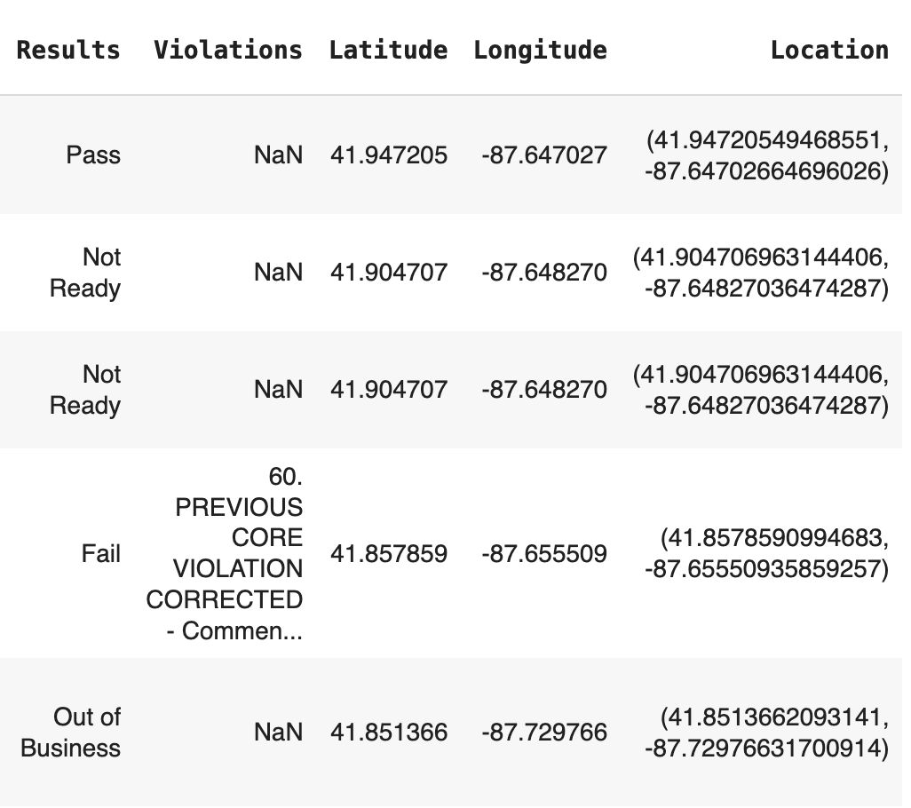
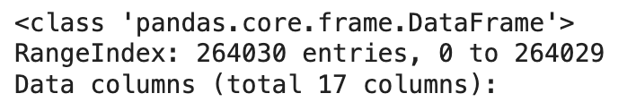

Slide 6
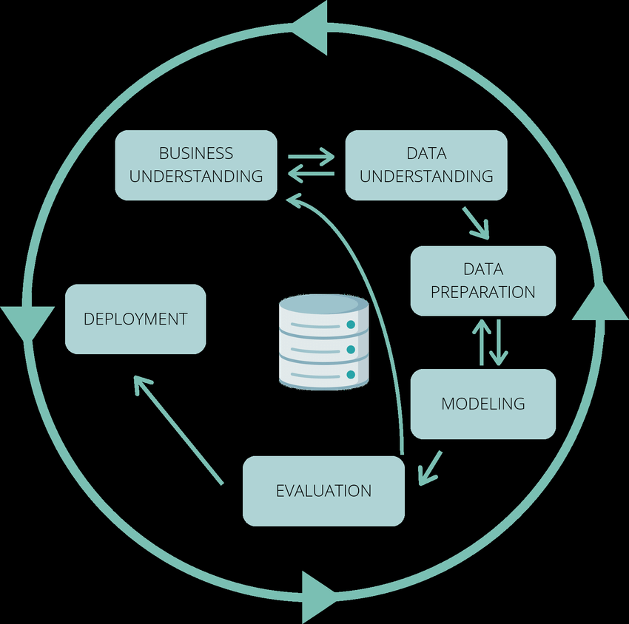
Project Approach
CRISP-DM Methodology
Iteratively enhance features for improved model performance.

Slide 7
DATA PREPARATION
Data Fetching
Data Cleaning
Feature Selection
Data Transformation
Feature Engineering
Dimensionality Reduction
Notes:
The recent Salmonella outbreak associated with a Chicago taqueria, affecting over 55 individuals, underscores a critical food safety challenge in the city. This incident highlights how important it is to have strict oversight and preventative measures in place to protect health of Chicago residents and safety when they eat out. Our project's objectives are to investigate the outbreak, pinpoint its origins, and evaluate any gaps in food safety procedures that might have contributed to the event.

Slide 8

Business objectives:
EDA
Identify the most common facility type in the dataset and facility types that are associated with highest and lowest risk factors
Create geospatial maps, visualizing the distribution of food establishments and their risk levels across different locations.
Perform a time series analysis on the dataset, considering features such as Inspection Date.
Investigate the correlation between different features (e.g., Facility Type, Inspection Type) and the risk level.
Examine the types of violations reported and their frequency.

Slide 9
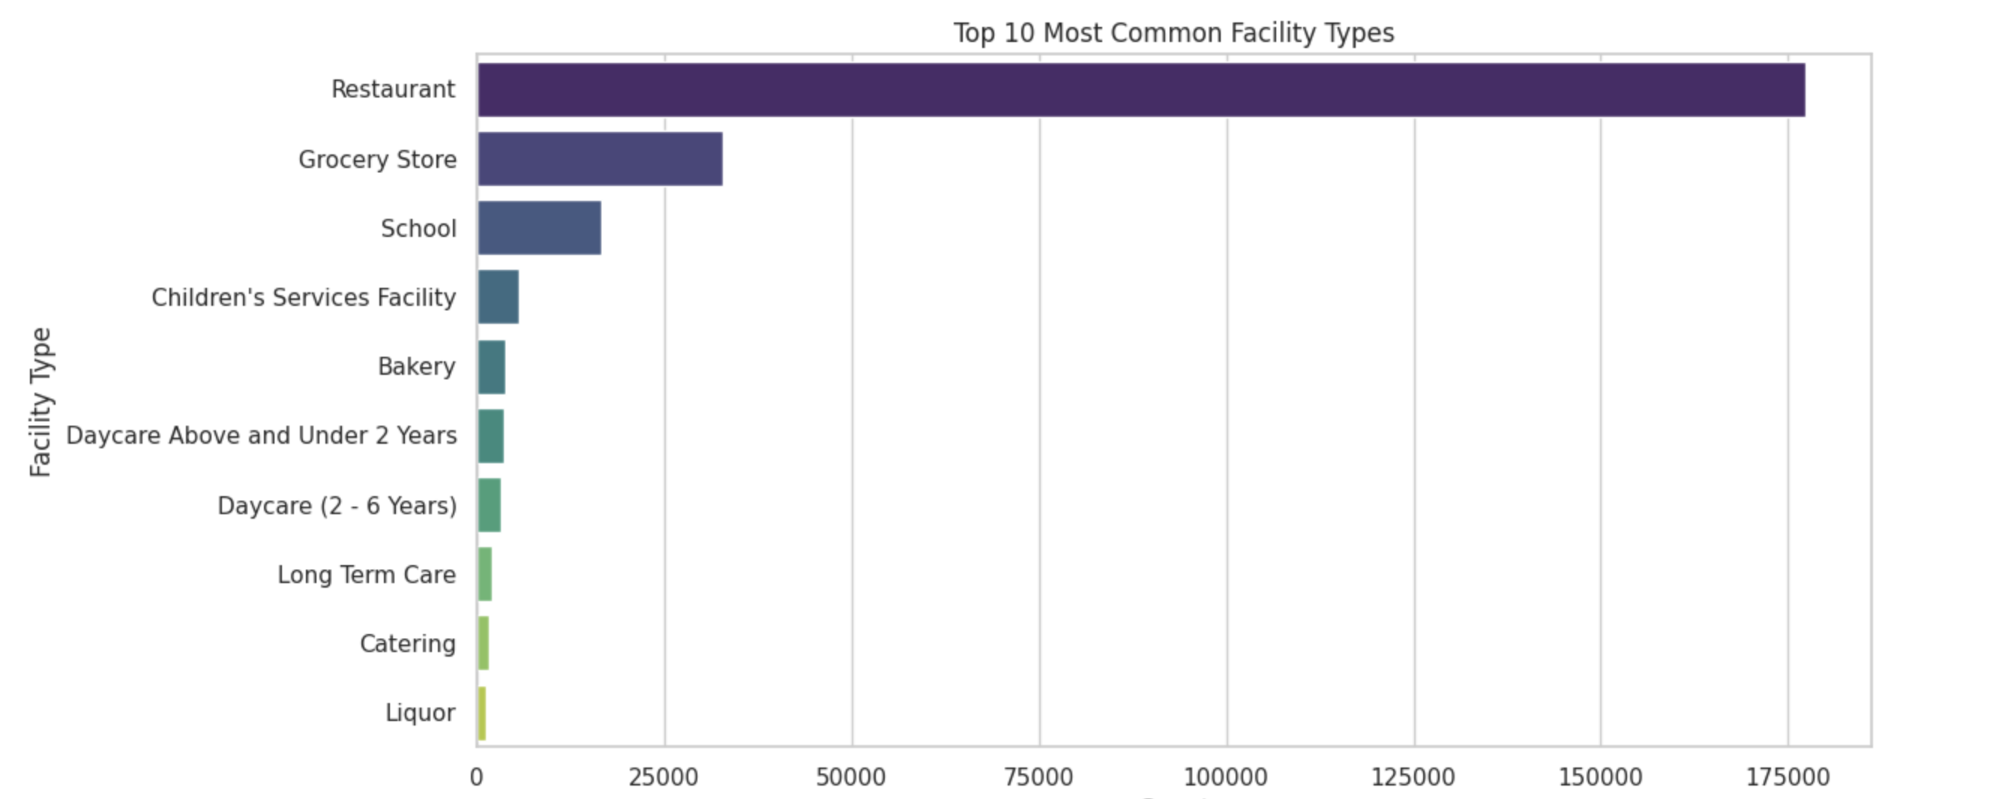
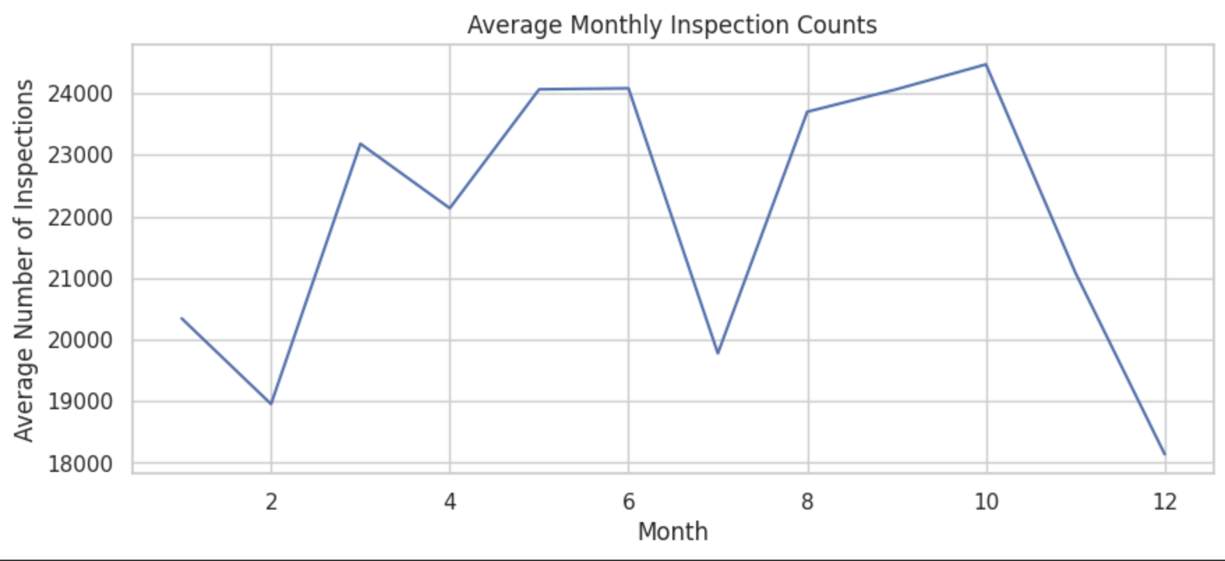
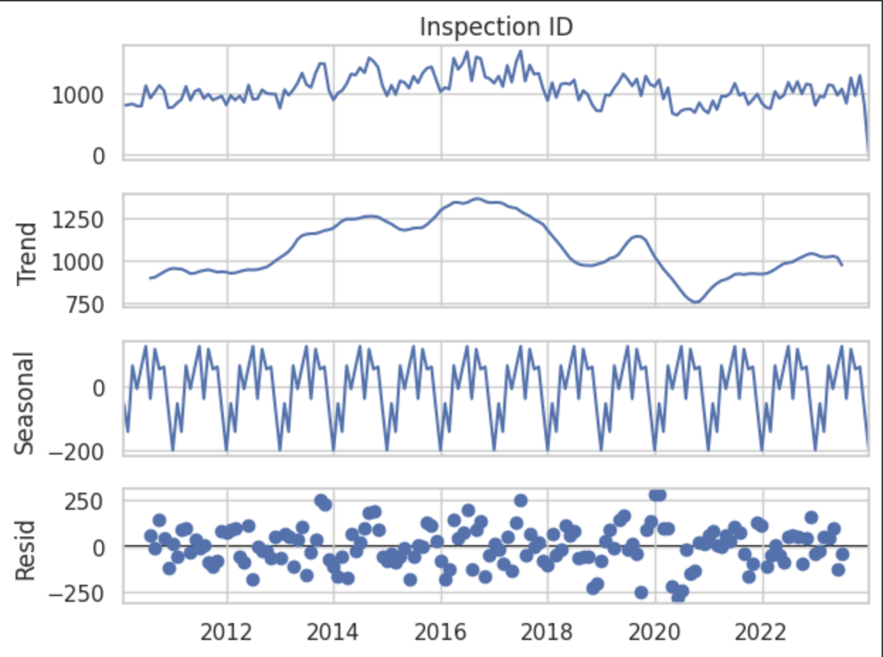
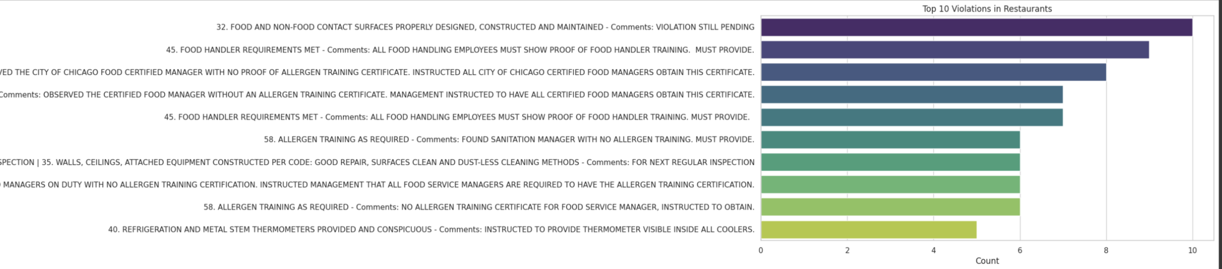
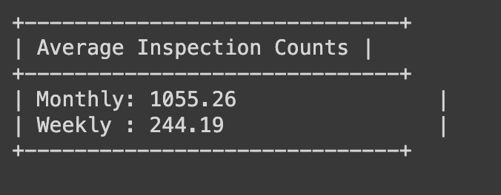

Slide 10
Business objectives:
Predictions and Forecasts
Develop a model to predict the Inspection Outcomes
Develop a model to assess the risk levels associated with different facility types
Choose the classification model that best fits this dataset by comparing them.
Displaying the output and conclusions of the model

Slide 11
Modelling Approach
Selected classification models based on to the nature of the problem, as the objective is to categorize and predict discrete outcomes. Employed a variety of classification and ensemble models for predictive analysis:
Decision Tree
Random Forest
XG Boost
K-Nearest Neighbors (KNN)
Support Vector Machine (SVM)
Voting Ensemble Classifier
Stacking Classifier

Slide 12
Model Selection
Model | Accuracy(Train) | Accuracy(Test)
Random Forest | 0.69 | 0.69
Decision Tree | 0.69 | 0.68
XG Boost | 0.68 | 0.68
K-Nearest Neighbors (KNN) | 0.66 | 0.65
Support Vector Machine (SVM) | 0.69 | 0.68

Slide 13

CHALLENGES FACED
Navigating data cleaning processes with a dataset of 7,760,592 rows, notably handling the last six months' data with over 1.3 million rows.
Addressing extended execution times during hyperparameter tuning and model training due to the substantial dataset size.
Notes:
The recent Salmonella outbreak associated with a Chicago taqueria, affecting over 55 individuals, underscores a critical food safety challenge in the city. This incident highlights how important it is to have strict oversight and preventative measures in place to protect health of Chicago residents and safety when they eat out. Our project's objectives are to investigate the outbreak, pinpoint its origins, and evaluate any gaps in food safety procedures that might have contributed to the event.

Slide 14
CONCLUSION
The Food Inspection team will have some helpful tools:
They can figure out which places need more attention to keep food safe.
They'll know beforehand what problems might happen in certain areas, making inspections better.
They can plan when and where to check places to use their time wisely.
They'll be able to predict issues in specific spots, so they can help those places do better before any big problems.

Slide 15
THANK YOU
Notes:
The recent Salmonella outbreak associated with a Chicago taqueria, affecting over 55 individuals, underscores a critical food safety challenge in the city. This incident highlights how important it is to have strict oversight and preventative measures in place to protect health of Chicago residents and safety when they eat out. Our project's objectives are to investigate the outbreak, pinpoint its origins, and evaluate any gaps in food safety procedures that might have contributed to the event.

